Slide 1


Foundations of
Scientific Computing
Dave Biersach
dbiersach@bnl.gov
Session 02
Arrays and Algorithms

Slide 2
Session 02 – Goals
Declare user defined functions using def keyword
Use if and else statements for conditional code execution
Review the modulus operator and perfect numbers
Import modules to call existing functions in other packages
Create an array of numbers using Numpy
Apply vectorized operators to an array of numbers
Calculate the divergence of the harmonic series
Review Euler's analytic solution to the Basel Problem
Create arrays of pseudo-random numbers using a seed

Slide 3
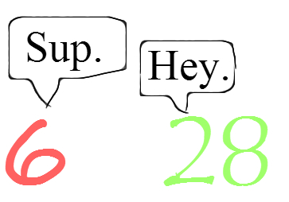
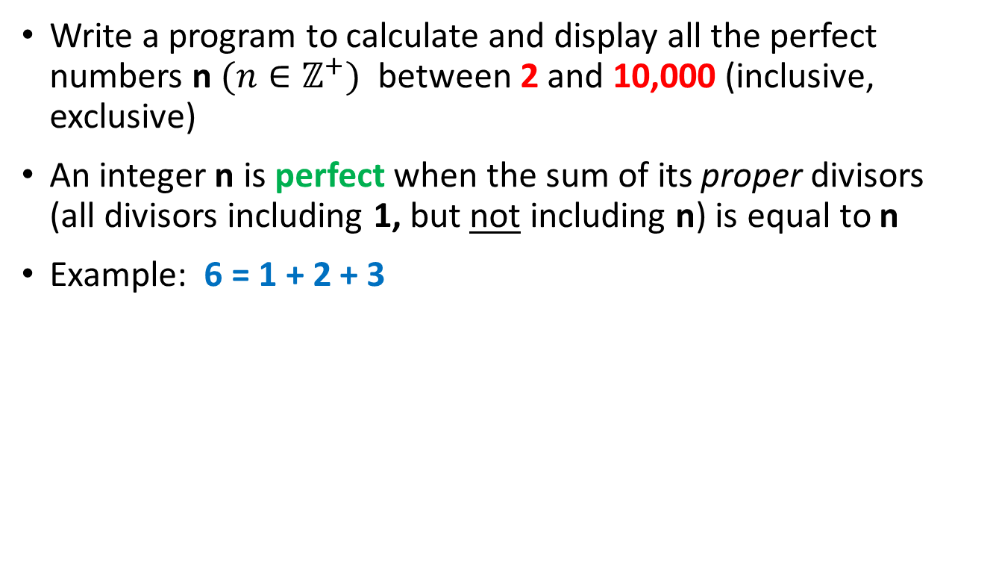
Perfect Numbers
Write a program to calculate and display all the perfect numbers n $(n∈ℤ^{+})$ between 2 and 10,000 (inclusive, exclusive)
An integer n is perfect when the sum of its proper divisors (all divisors including 1, but not including n) is equal to n
Example: 6 = 1 + 2 + 3

Slide 4
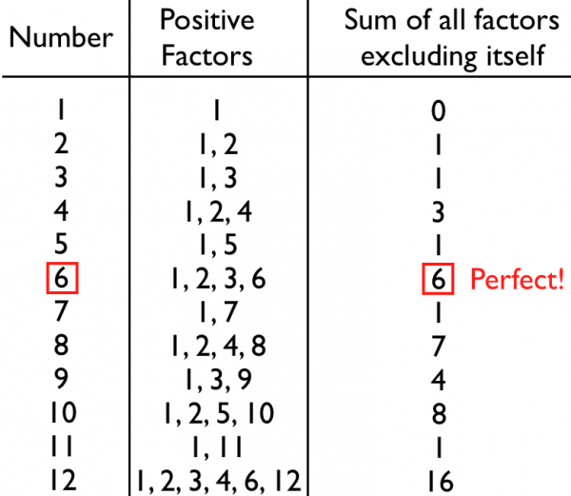
Perfect Numbers

Slide 5
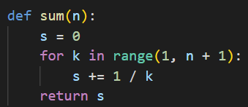
def Statement
The function name
def is how we define a function
Be mindful of the colons : that start the scopes
The inbound parameters
Statements within a scope are indented
Functions can return values

Slide 6
if Statement
An if statement identifies which code block (scope) to run based upon the value of a Boolean expression
The expression (the condition) must evaluate to either a True or a False value
If the condition is True, then the scope immediately following the if statement is executed
If the condition is False, and there is an else clause, then the scope immediately following the else statement is executed
Every if statement does not need to have an else clause
You can also use elif to continue to test for other conditions
The if, elif, and else statements all introduce scopes (meaning they require a colon at the end of their line)

Slide 7
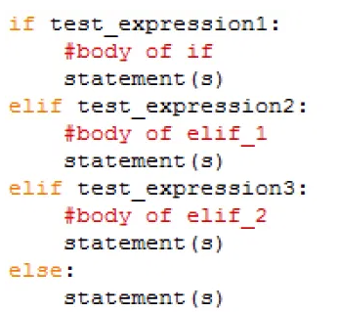
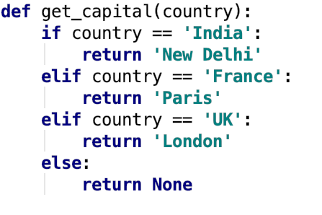
if Statement
def is how we define a function
Functions can return values
Be mindful of the colons : that start the scopes

Slide 8
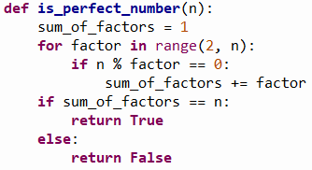
The Modulus (%) Operator
The “mod” operator (%) returns the integer remainder of an implicit division operation, e.g., 37 % 5 = 2
Use double equals operator (==) when testing for equality

Slide 9
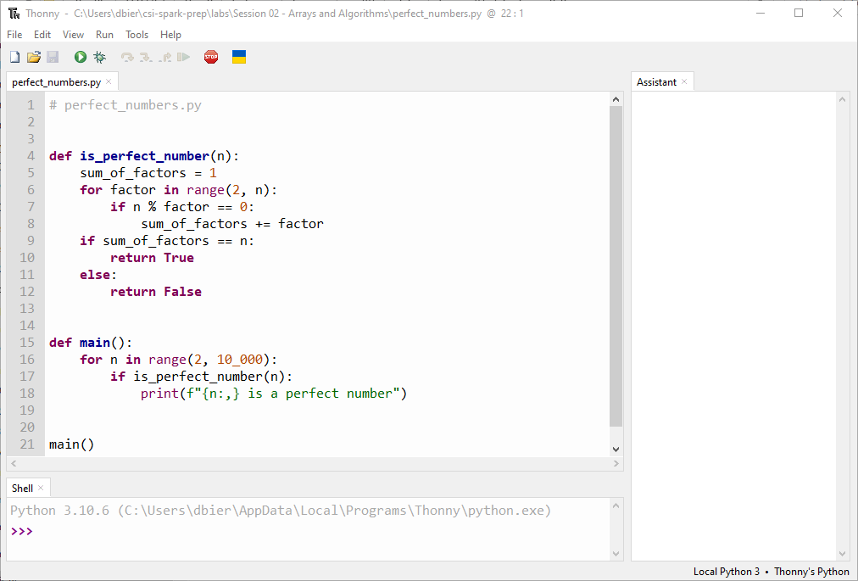
Edit perfect_numbers.py
Type this code into your Thonny IDE
⑤
⑥
⑦
⑧
⑨
②
③
④
⑩
①

Slide 10
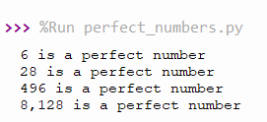
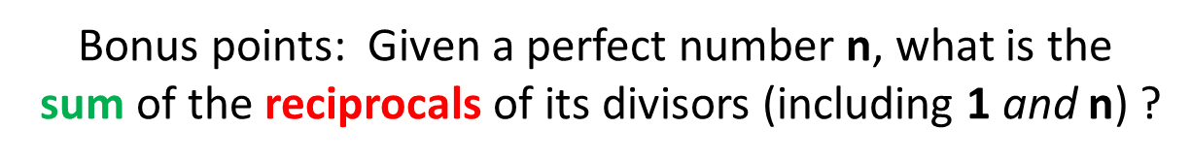
Run perfect_numbers.py
Do you notice anything special about these numbers?

Slide 11
Perfect Numbers
Euclid–Euler theorem
$$\left\{p,\left(2^{p}−1\right) \right\}∈primes→2^{\left(p−1\right)}\left(2^{p}−1\right) is perfect$$
Note: This formula might not be the only one to generate perfect numbers – we still don't know for sure!

Slide 12
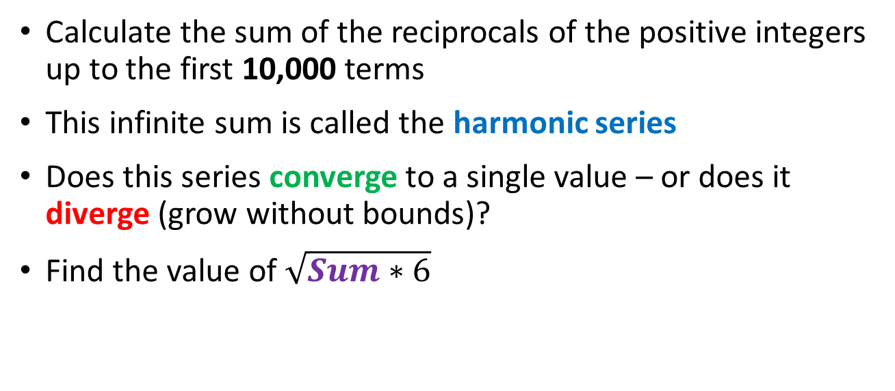
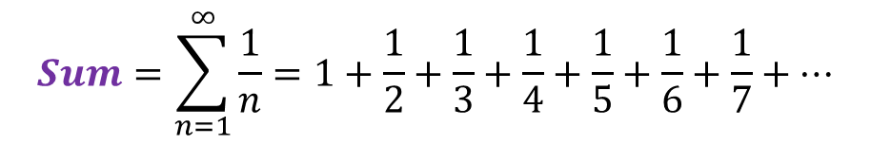
The Harmonic Series
$$Sum=\sum_{n=1}^{∞}{\frac{1}{n}=1+\frac{1}{2}+\frac{1}{3}+\frac{1}{4}+\frac{1}{5}+\frac{1}{6}+\frac{1}{7}+…}$$
Calculate the sum of the reciprocals of the positive integers up to the first 10,000 terms
This infinite sum is called the harmonic series
Does this series converge to a single value – or does it diverge (grow without bounds)?
Find the value of $\sqrt{Sum∗6}$

Slide 13
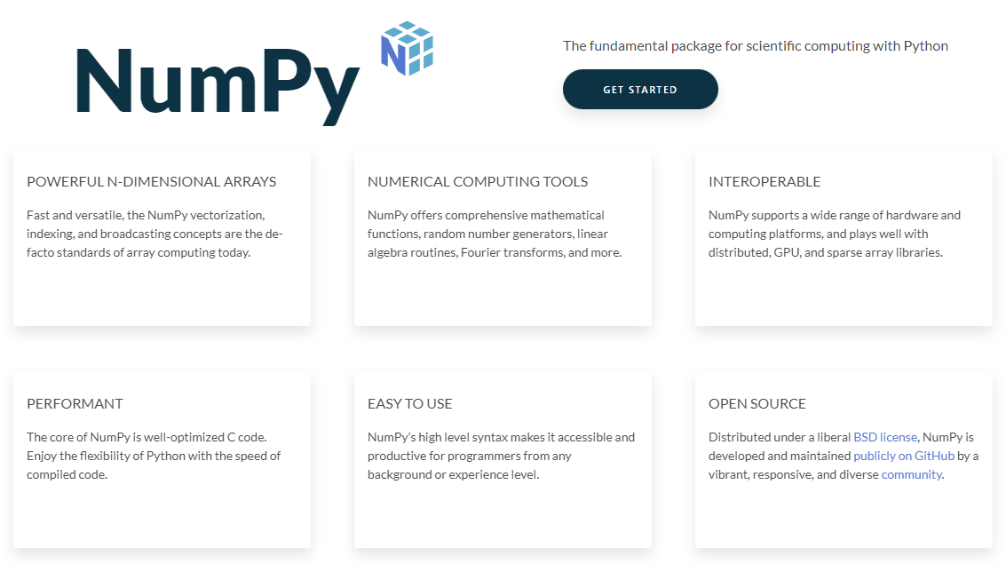
Importing Packages
https://numpy.org

Slide 14
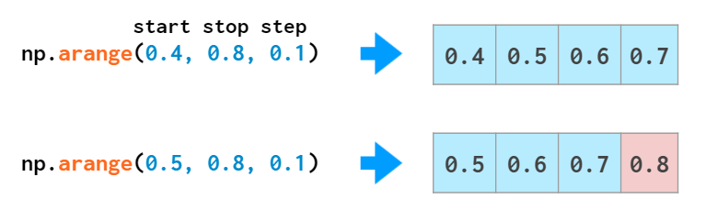
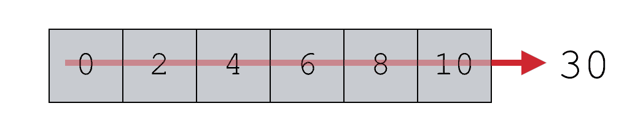
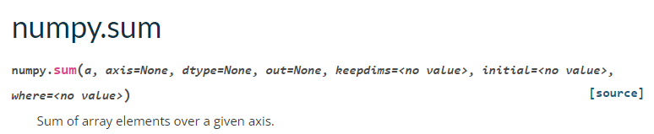
Numpy Arrays

Slide 15
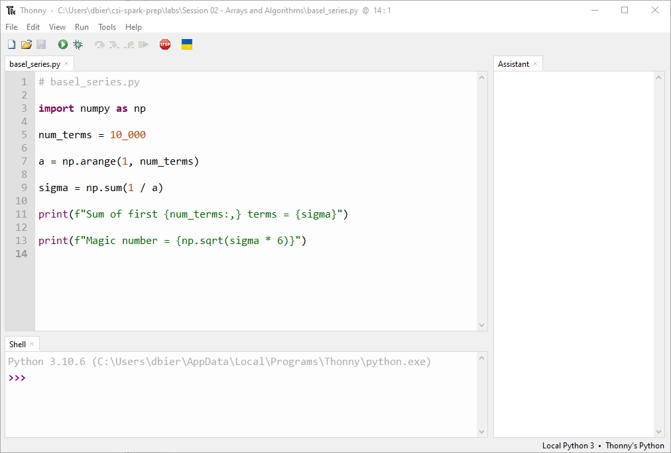
Edit basel_series.py
①
②
③
④
⑤
⑥
Type this code into your Thonny IDE

Slide 16
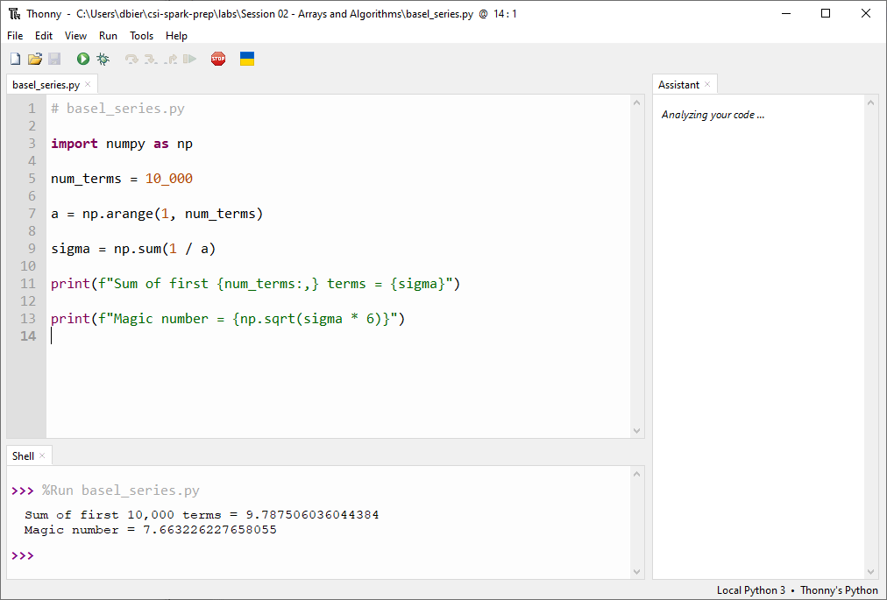
Run basel_series.py
⑦

Slide 17
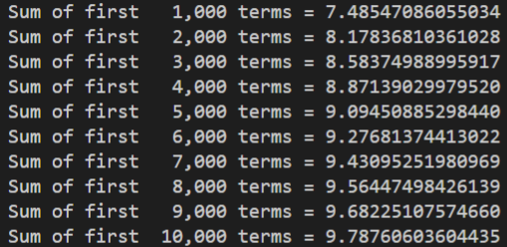
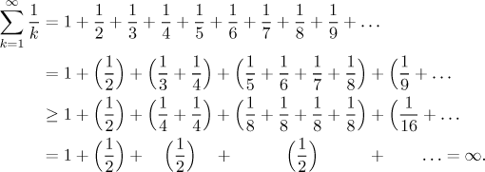
The Harmonic Series Diverges
The harmonic series diverges
Nicole Oresme (c. 1360)

Slide 18
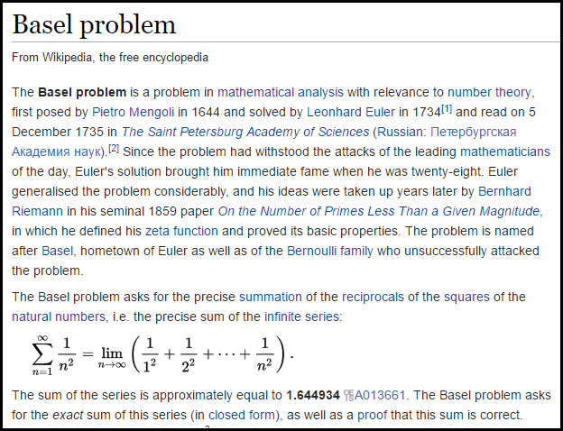

Slide 19
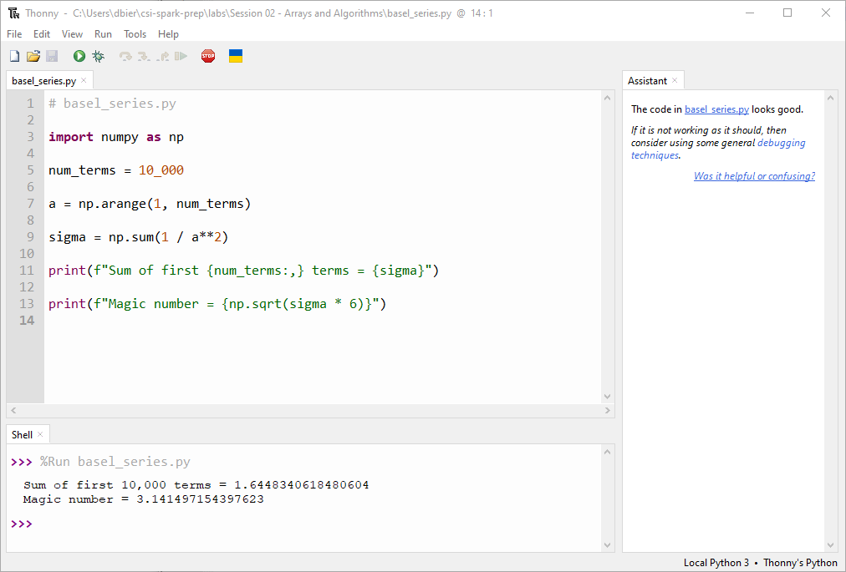
Edit then Run basel_series.py
①
②

Slide 20

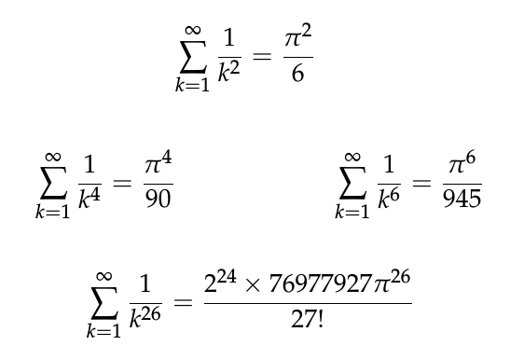
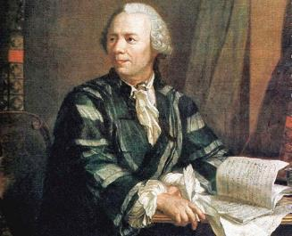
Run basel_series.py
The Basel series converges

Slide 21
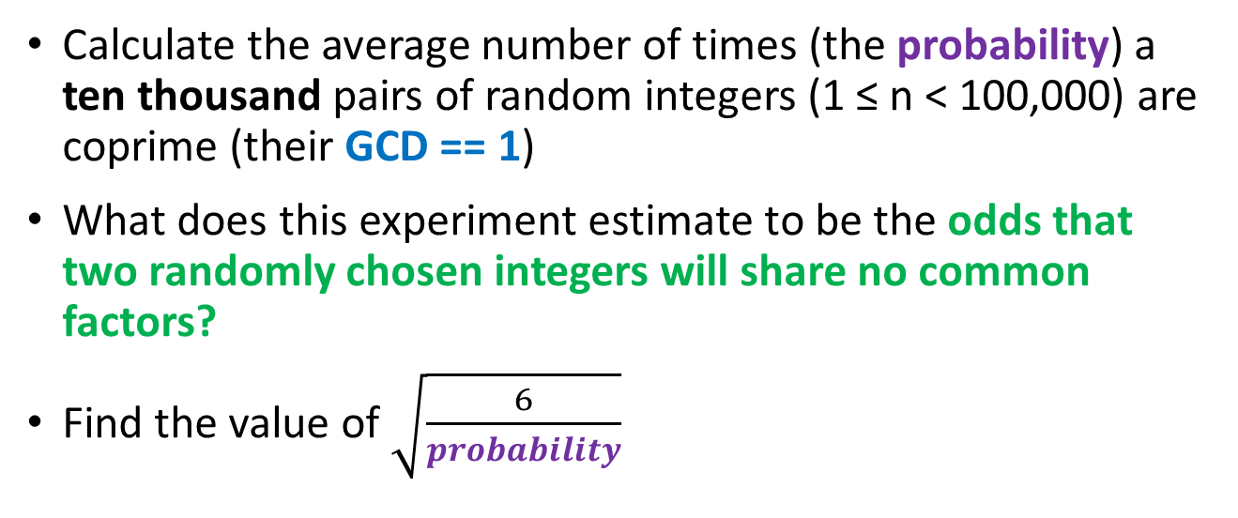
Coprime Probability
Calculate the average number of times (the probability) a ten thousand pairs of random integers (1 ≤ n < 100,000) are coprime (their GCD == 1)
What does this experiment estimate to be the odds that two randomly chosen integers will share no common factors?
Find the value of $\sqrt{\frac{6}{probability}}$

Slide 22
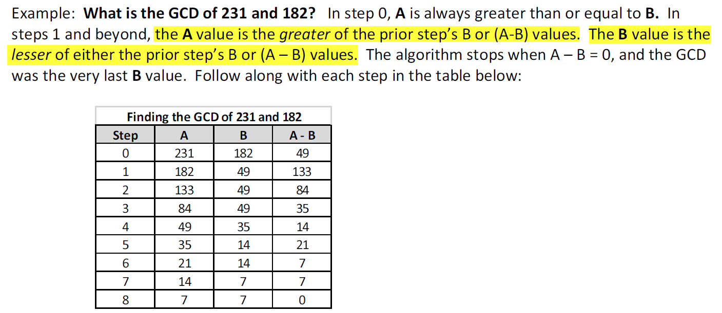
Greatest Common Divisor (GCD)
What divides A and B must also divide the difference of A - B
Why?
Given {A, B, a, b, r} ∊ ℤ
$$A=a ∗r, B=b ∗r$$
$$\left(A −B\right)=a∗r −b ∗r$$
$$a −b= \frac{\left(A −B\right)}{r}$$
∴ One can determine the GCD without having to factor either of the two integers!

Slide 23
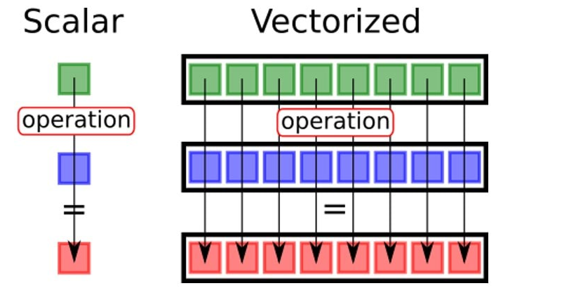
Numpy Vectorized Operations

Slide 24
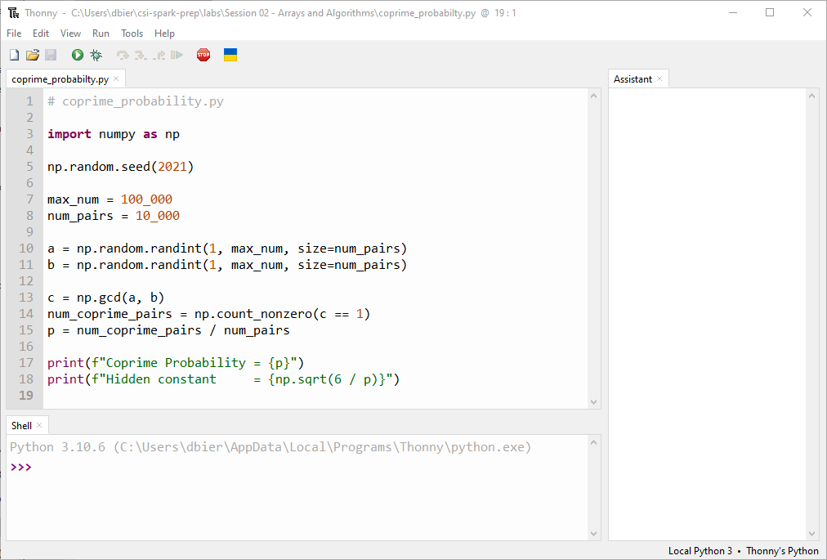
Edit coprime_probability.py
Type this code into your Thonny IDE
①
②
③
④
⑤
⑦
⑥
⑧

Slide 25




Run coprime_probability.py
Leonhard Euler
(1707-1783)

Slide 26
Python vs Java/C++
Python is a dynamically typed language
It is not necessary to declare the type of a variable before assigning a value to it, and a variable can change its type within a scope
In Python, a variable doesn't hold anything – a variable name is just a label for a static value
Function names are normally followed by parenthesis ()
Both functions and statements can introduce scopes using a colon :
Python is whitespace sensitive!
A scope is not enclosed in curly braces {} like in Java/C++
Horizontal indentation is how you denote scopes in Python
All statements sharing the same scope must be vertically aligned

Slide 27
Python vs Java/C++
Python is an interpreted language, not normally compiled
The reference implement of Python is CPython, which is a Python interpreter written in C++
Python does not use a classical static linker – you can easily call external code residing in external modules/packages on-the-fly
Python code is inherently more functional (declarative) than procedural (imperative) like Java/C++
With procedural languages you must tell the computer step-by-step how exactly to accomplish what you want
With functional languages you tell the computer what you want to accomplish, and it determines the best way to satisfy your request

Slide 28
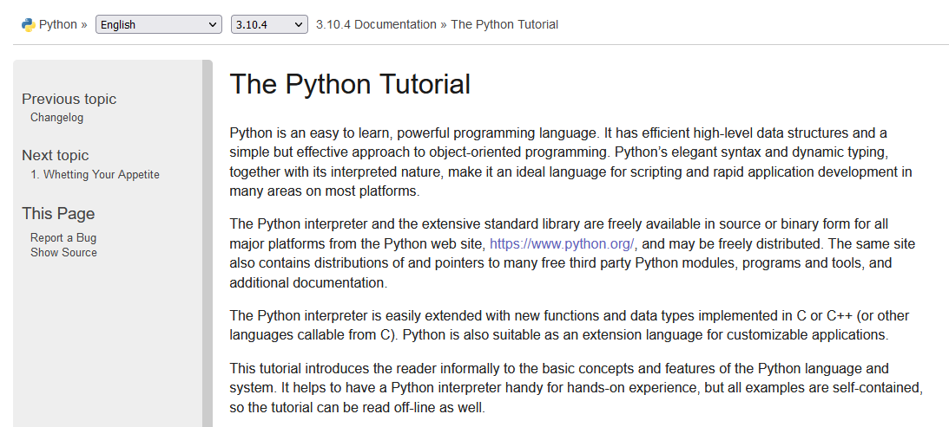
The Python Tutorial
https://docs.python.org/3/tutorial

Slide 29
Session 02 – Now You Know…
How to import modules using the import statement
How to declare custom functions using def
Execute code blocks (scopes) conditionally using if and else
Create an array of numbers using np.arange()
Apply vectorized operators to a NumPy array
Create arrays of pseudo-random numbers using a seed
Using single underscore character for thousands separator in numeric literals

Slide 30
Task 02-01
Write a Python program called lcm_gcd.py to calculate the lowest common multiple (LCM) of two integers
You may only use basic arithmetic operators - no looping constructs, such as a for loop
You may also leverage the Numpy greatest common divisor (GCD) function
Calculate and display the LCM of 447618 and 2011835

